Slide 1
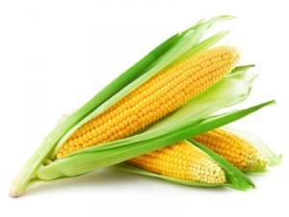
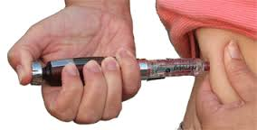
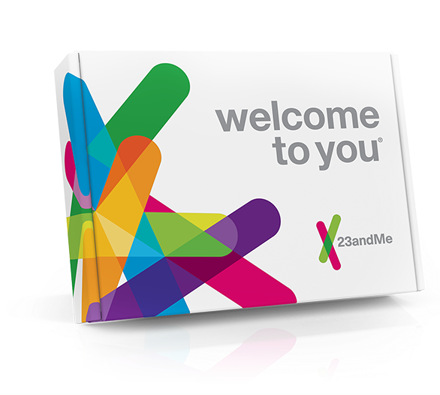
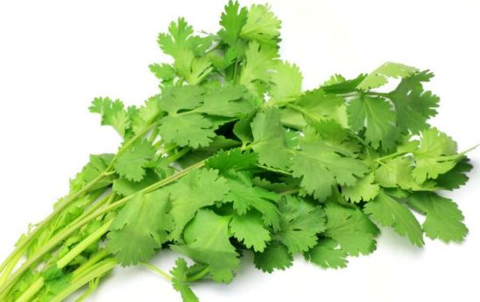
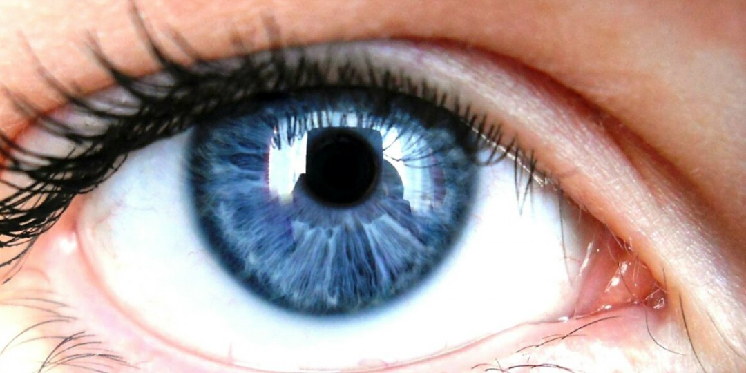
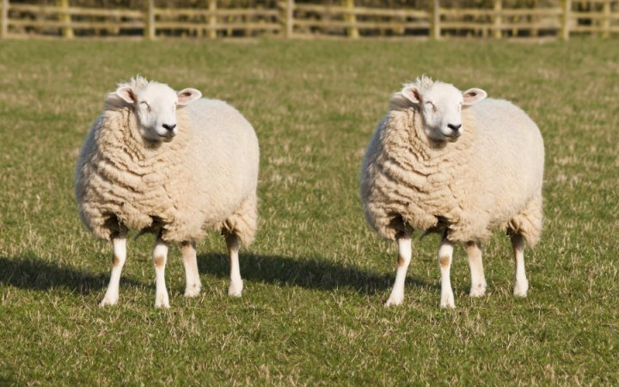
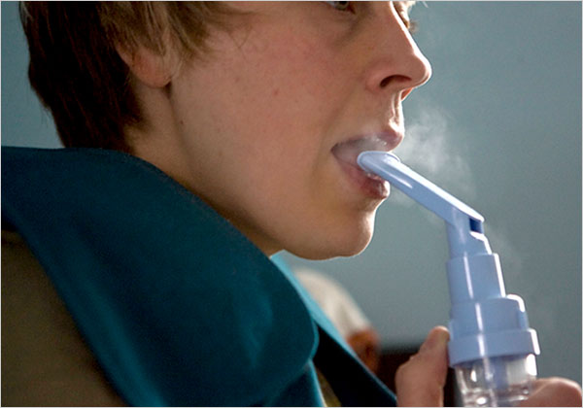
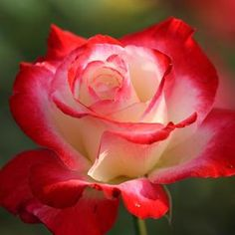

Slide 2
Quick quiz
What is the name given to a group of organisms of the same species living together in a particular place at a particular time?
What are the two main types of mutations?
State the differences between somatic and germline mutations

Slide 3
Quick quiz
Population
Gene and chromosomal
Somatic individuals affected, occurs in body cells Germline offspring affected, occurs in gametes

Slide 4
Gene mutations
Affects individual genes
Genes code for proteins
Disruption of base sequences may result in
No change
Change of protein structure
Disrupt protein production

Slide 5
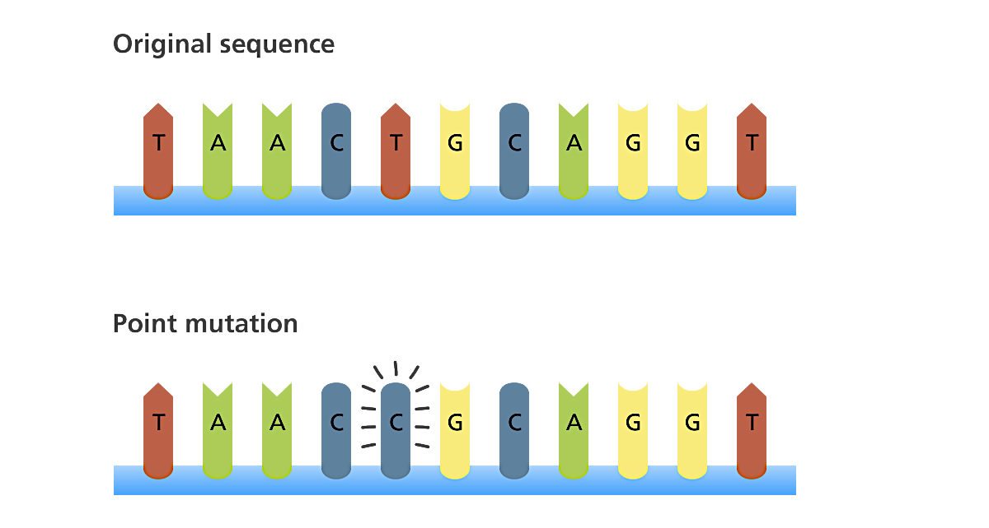
Point mutation
A change in just one base sequence

Slide 6
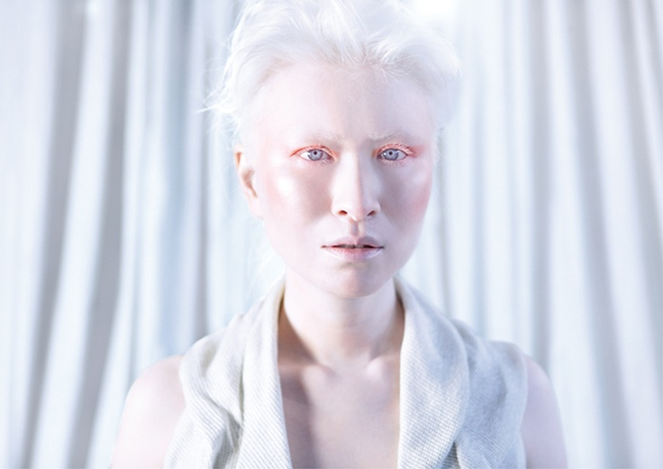

Slide 7
Albinism
Absence of pigment in hair, skin and eyes
Hair – whitish blonde
Skin – extremely pale
Eyes – pinkish
Mutation of the genes involved in melanin production

Slide 8
Duchenne Muscular Dystrophy
Mutation in mother which can be passed down to her son
Or mutation in the zygote
Wasting of muscles (legs first and later arms etc.)
Evident by 3-5 years due to muscle weakness
Death due to failure of respiratory muscles

Slide 9
Cystic Fibrosis
Mutation of gene found on chromosome 7
Gene codes for protein that regulates the passage for chloride ions across the cell membrane
Symptoms: salty-tasting skin; persistent coughing; wheezing or pneuomnia; digestive and other problems
Mutant allele is recessive

Slide 10
Lethal Recessives
Most gene mutations produce a recessive allele
Some mutations are lethal if they are not masked by a dominant normal allele
Causes death of embryo of foetus (miscarriage)

Slide 11
Tay-sachs disease (TSD)
Disorder of lipid metabolism
Autosomal recessive
Condition is lethal due to missing enzyme
Results in fatty substance in the nervous system
Symptoms: develop normally for first few months, deteriorates, mental and physical disabilities surface – death in early childhood

Slide 12
Lethal recessive alleles result in death of an individual. How would this affect the allelic composition of a gene pool?

Slide 13
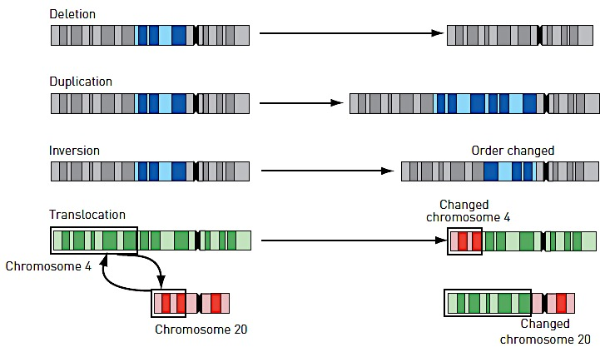
Chromosomal mutations

Slide 14
Remember!
Chapter review due Thursday 14th

